Slide 1
Hospital Management
Application
Shrikrishna Subhas Nayak
Ritik Gupta
Aniket Patole
Team KRA

Slide 2
Managing hospital data and staff with revenue and medicine stock analysis.
Streamlining administrative tasks for hospital admin, test lab admin, pharmacy admin.
Analyzing Revenue for hospital with amount of cash-flow coming into the hospital through doctor appointments, lab tests ordered and Medicines purchased.
Giving medical insurance for a patients.
1
Objective

Slide 3
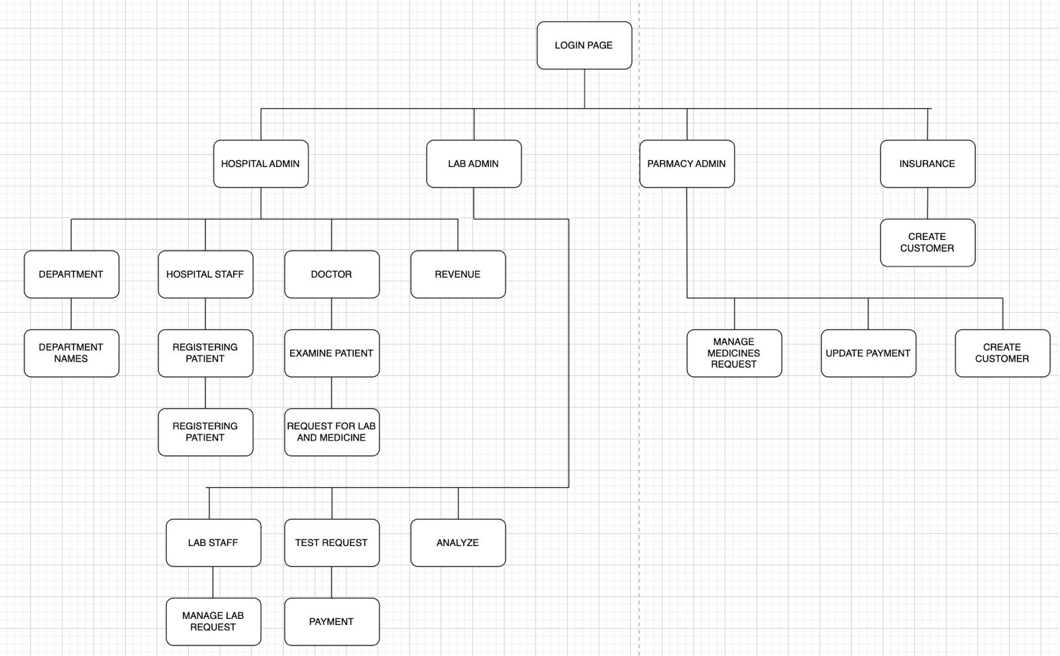
UML Diagram

Slide 4
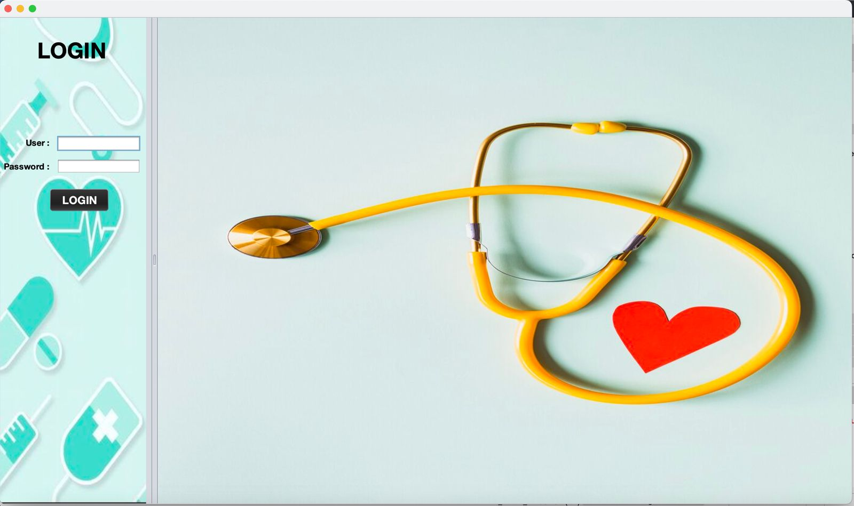
Screenshots

Slide 5
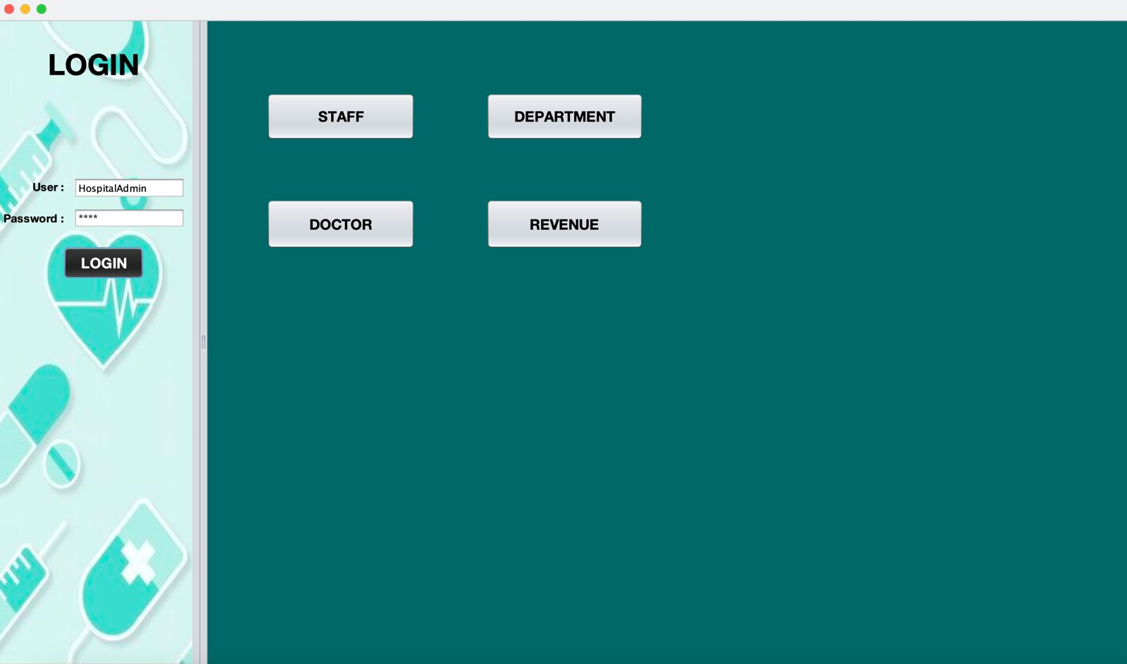

Slide 6
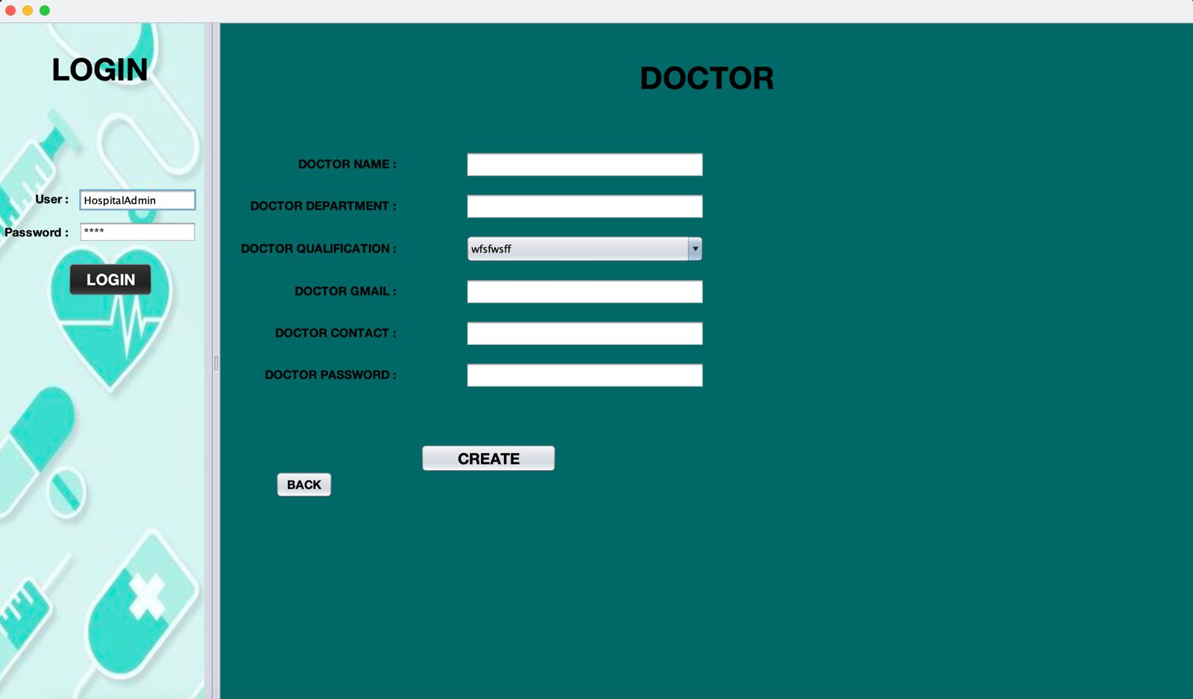

Slide 7
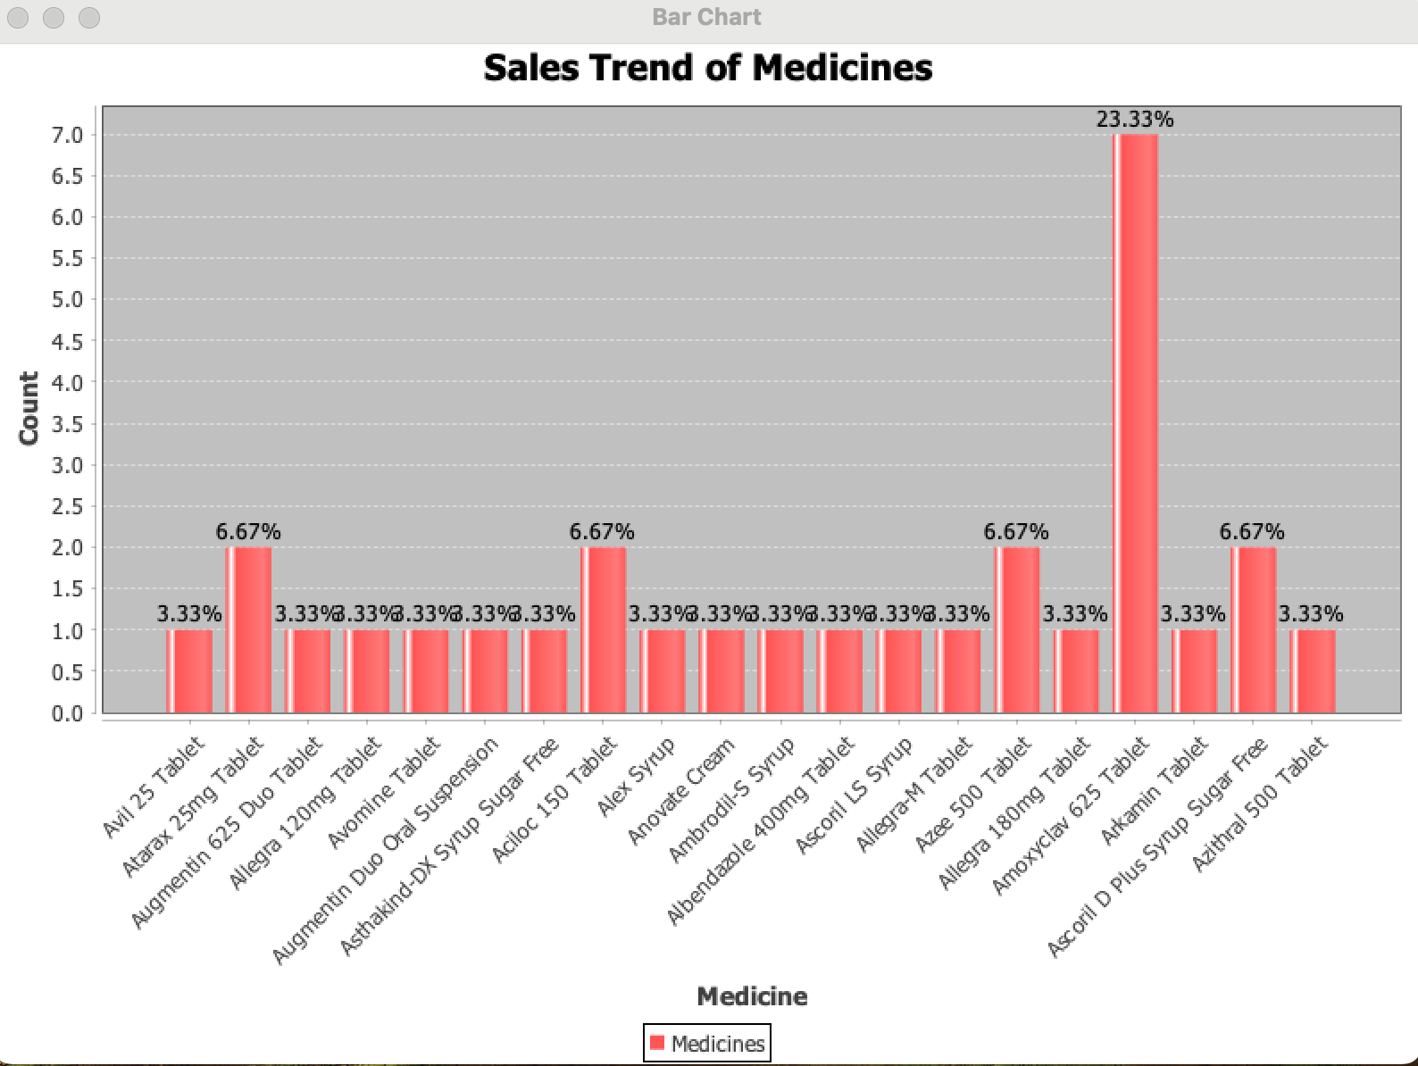
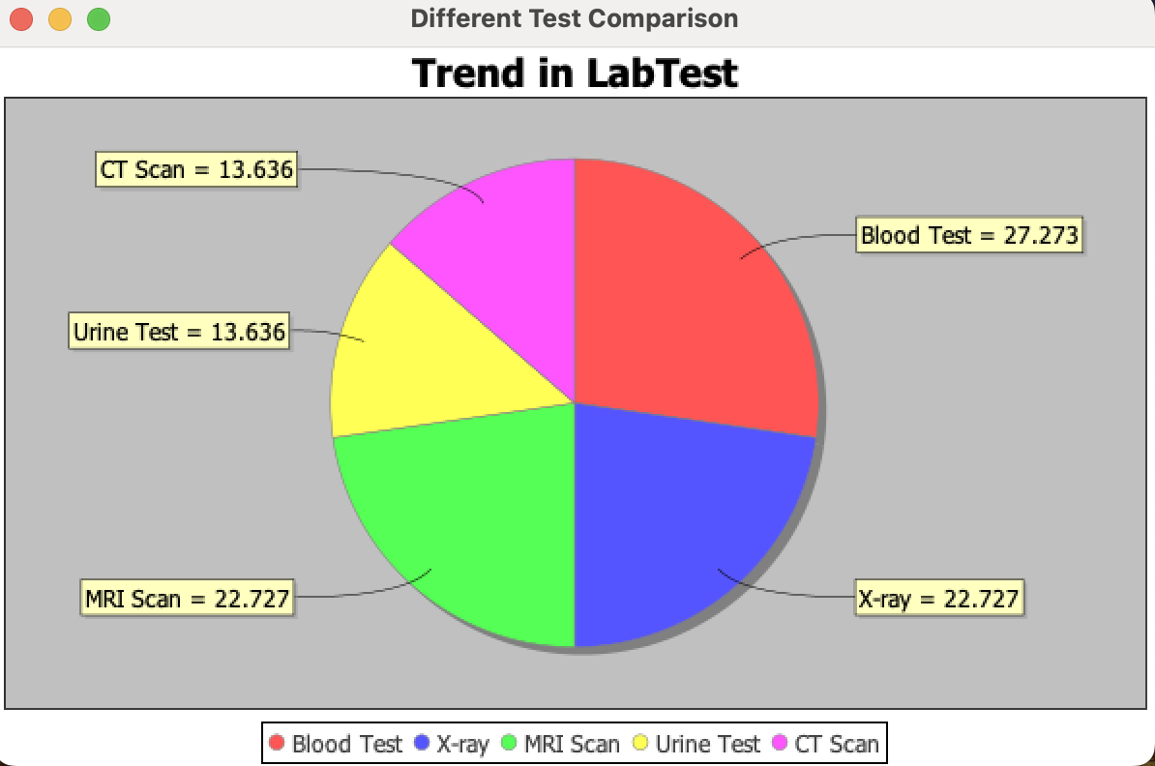
Charts for Market Trend Analysis

Slide 8
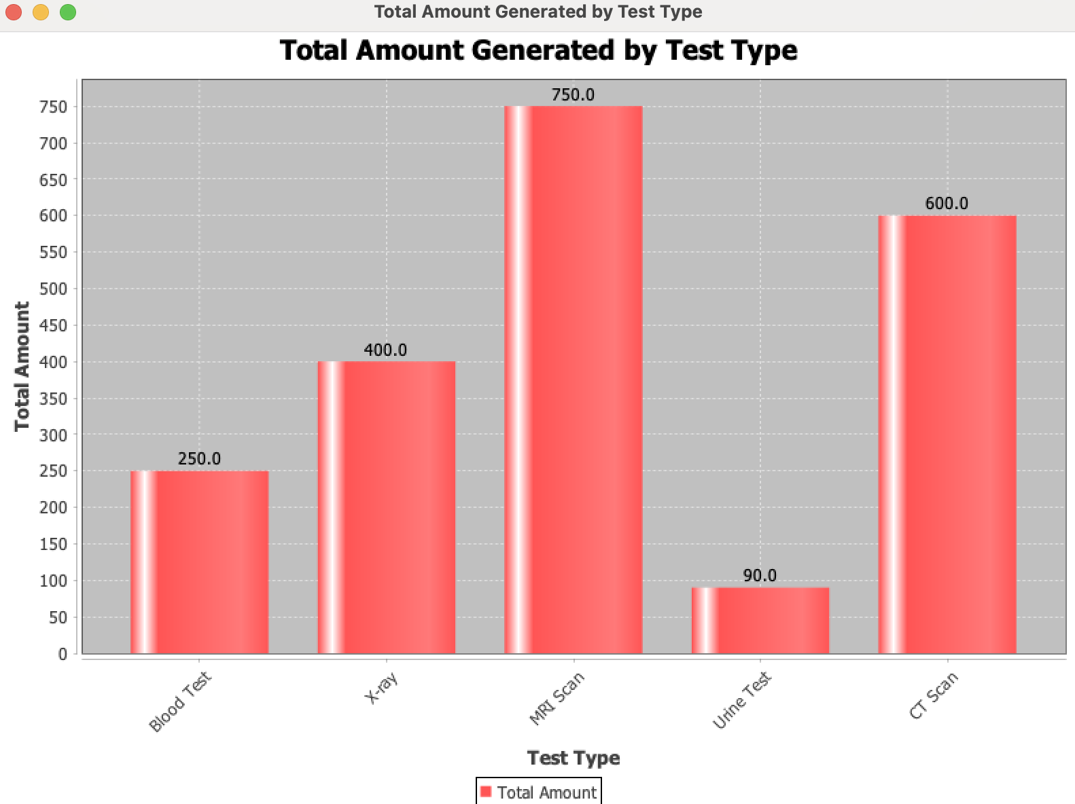
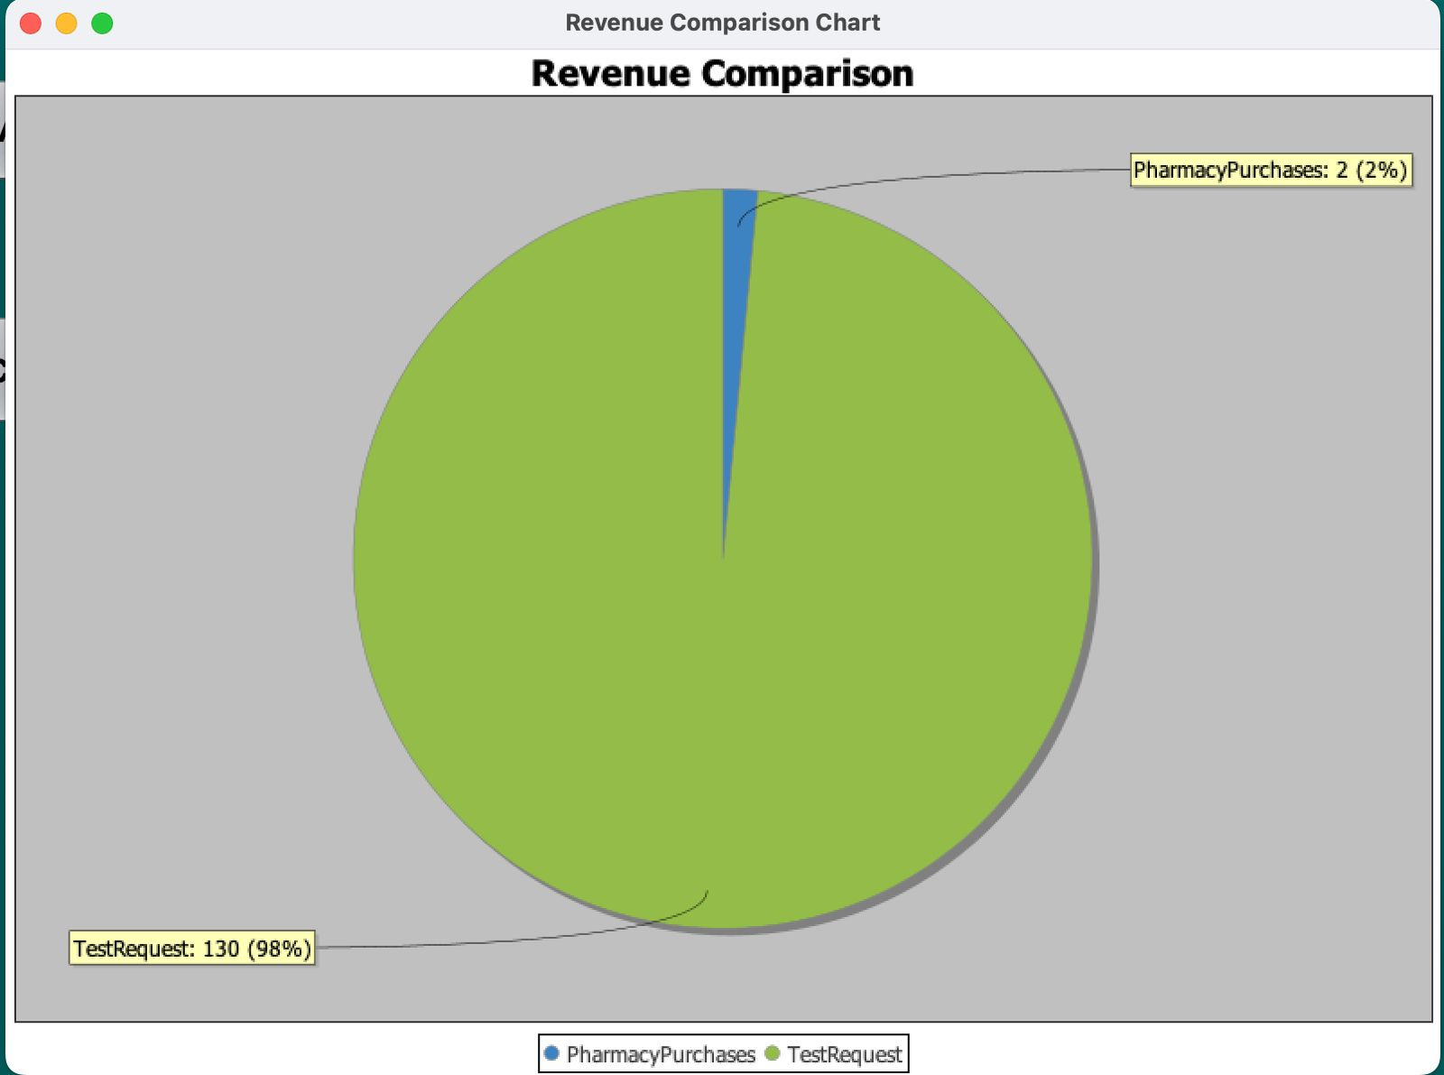
Charts for Revenue Analysis

Slide 9
Advanced Analytics and generative AI for better resource allocation, higher data population.
Fast & Easy appointment scheduling.
Enhanced Security And Privacy Measures.
Future Application and website in android as well as IOS.
Patient Centric Approaches based on personalized health care plans and facilities.
Future Scope

